Slide 1

Business Insights New York Housing Market
Data Science SQL Mini-Project
By KHUSHI

Slide 2

Agenda
Introduction
Dataset Overview
Methodology
Insights
Conclusion
Future Work

Slide 3

Introduction
DATASET
The dataset provided contains information about various houses, based on the brokers, types, price range, capacity and location of the houses.
OBJECTIVE
The project objectives involve analyzing this dataset to gain insights and understand the trends in the New York housing market.
SIGNIFICANCE
This analysis provide valuable information for real estate professionals and investors looking to understand trends in the New York housing market. Brokers can use these insights to tailor their listings based on popular property types and locations with high demand. Also, understanding average prices per square foot and bedroom distribution can help in pricing strategies and market positioning.

Slide 4
Dataset Overview
BROKER TITLE
Title of the broker
TYPE
Type of the house
PRICE
Price of the house
BEDS
Number of bedrooms
BATH
Number of bathrooms
PROPERTYSQFT
Square footage of the property
ADDRESS
Full address of the house
STATE
State of the house
MAIN_ADDRESS
Main address information
ADMINISTRATIVE_AREA_LEVEL_2
LOCALITY
Locality information
SUBLOCALITY
Sublocality information
STREET_NAME
Street name
LONG_NAME
Long name
FORMATTED_ADDRESS
Formatted address
LATITUDE
Latitude coordinate of the house
LONGITUDE
Longitude coordinate of the house
Administrative area level 2 information

Slide 5






Methodology
Exploring Data
Exploring the dataset thoroughly
Data Interpretation
Interpreting the results based on analysis
Data Cleaning
Checking for errors and correcting them
Insight Generation
Generating meaningful business insights
Data Analysis
Applying techniques to the data to discover patterns or relationships.
Data Visualization & Story Telling
Visualizing data to make it more understandable and providing a clear picture of the findings

Slide 6

Business Insights
Let’s dive in

Slide 7
1. Average Price & Count by Type
PRICE
COUNT
It provides insight into the price variation and total count of houses based on different types of houses.

Slide 8
2. Average Price & Count by Locality
It provides insight into the price variation and total count of houses based on different localities.

Slide 9
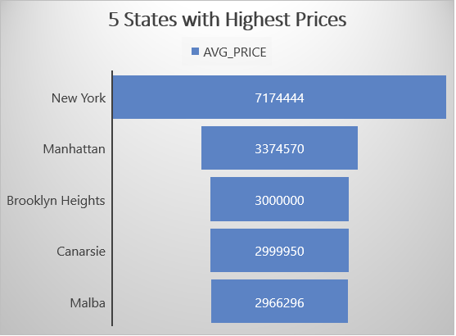
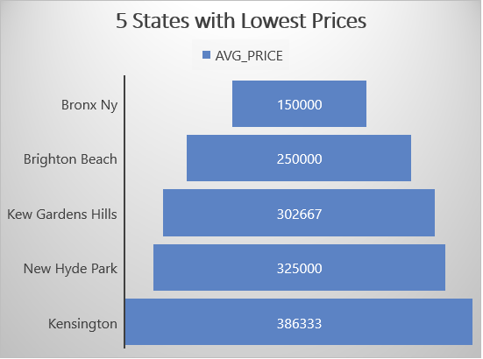
3. Average Price by States
It provides insight into the 5 states with most expensive houses.
It provides insight into the 5 states with least expensive houses.

Slide 10
4. Count of Houses by Brokers
It shows the 5 brokers with the highest number of listed houses.

Slide 11
5. Count of Houses by Street Name
It shows the 5 most common street names with maximum number of houses.

Slide 12
6. Average Number of Beds and Baths by Type
It provides insights into the variation in capacity of houses depending on types of houses.

Slide 13
7. Count of Houses in New York State
It provides insight into the total count of houses based on types of houses available in New York state.

Slide 14

Conclusion
New York has the highest prices and count of houses.
Bronx has the lowest prices and count of houses.
Co-op types of houses are the houses available in every state and has the highest count. These are affordable by all kinds of buyers.
Whereas, Townhouse types of houses are most expensive and luxurious houses.
COMPASS broker deals on large scale and has the highest listings in every area.
Manhattan street has the highest count of houses and are mostly preferred by buyers.

Slide 15

Challenges and Lessons
Challenges
Lessons
Finding insights from the database
Relating them as per the requirements
Maintaining the accuracy and consistency of data.
Effective presentation
Adjusting content to present within the time frame.
Utilizing advanced analytics techniques
Using SQL in practical prospect
Finding the real world insights
Analytical thinking
Communication of insights
Arranging data to look effective

Slide 16
Future Work
Exploring trends in the New York housing market, such as identifying emerging neighborhoods or predicting future price movements.
Conducting sentiment analysis on real estate listings or customer reviews could also offer insights into buyer preferences and sentiments.
Overall, continuing to refine and expand the analysis based on new data sources and methodologies can help stakeholders make more informed decisions in the real estate market.

Slide 17

Thank You

